Slide 1
Linked List

Slide 2
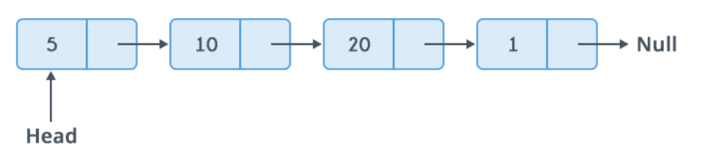
Linked List is a sequence of links which contains items. Each link contains a connection to another link.

Slide 3
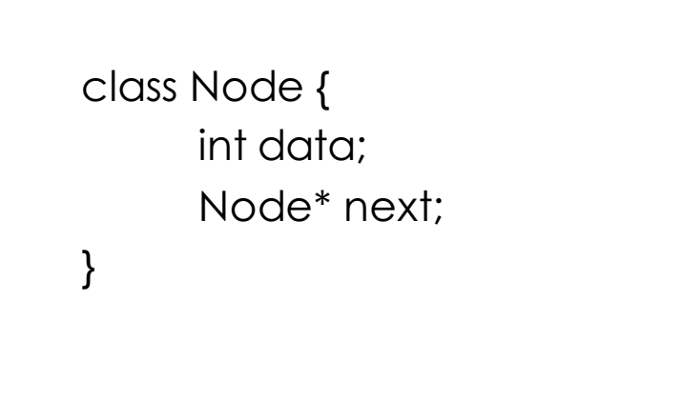
A node is a collection of two sub-elements or parts. A data part that stores the element and a next part that stores the link to the next node.

Slide 4
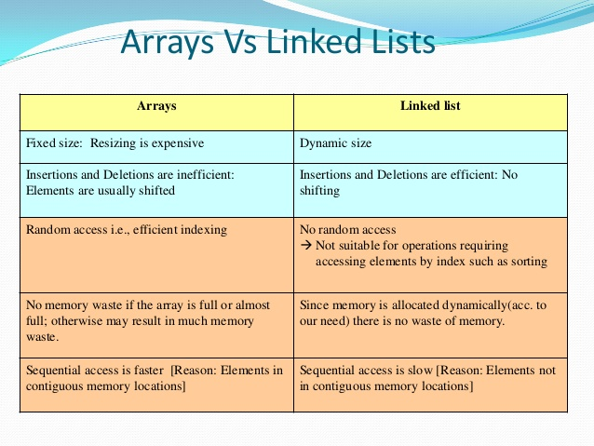

Slide 5
Types of Linked List
Simple Linked List − Item navigation is forward only.
Doubly Linked List − Items can be navigated forward and backward.
Circular Linked List − Last item contains link of the first element as next and the first element has a link to the last element as previous.

Slide 6
Basic Operations
Following are the basic operations supported by a list.
Insertion − Adds an element at the beginning of the list.
Deletion − Deletes an element at the beginning of the list.
Display − Displays the complete list.
Search − Searches an element using the given key.
Delete − Deletes an element using the given key.

Slide 7
Insertion
node* addNode(node*head, int value){
node *p;// declare two nodes temp and p
node*temp = new node;//createNode will return a new node with data = value and next pointing to NULL.
temp->data = value; // add element's value to data part of node
if(head == NULL){
head = temp; //when linked list is empty
}
else{
p = head;//assign head to p
while(p->next != NULL){
p = p->next;//traverse the list until p is the last node.The last node always points to NULL.
}
p->next = temp;//Point the previous last node to the new node created.
}
return head;
}

Slide 8
Deletion of ith node
Node* deleteNode(Node* head, int i){
if(i == 0){
Node* newHead = head->next;
delete head;
return newHead;
}else{
int count = 0;
Node* temp = head;
while(count < i-1 && temp != NULL){
count++;
temp = temp->next;
}
// temp should point to i -1 th Node. Make sure temp and temp->next are != NULL
if(temp != NULL && temp->next != NULL){
Node* nodeToDelete = temp->next;
temp->next = nodeToDelete->next;
delete nodeToDelete;
}
return head;
}
}

Slide 9
Printing elements of a linked list
void print(Node* head){
Node* temp = head;
while(temp != NULL){
cout << temp->data << " ";
temp = temp->next;
}
cout << endl;
}

Slide 10
Lets practice at Hackerrank!
Q1. Insert a node at the head
https://www.hackerrank.com/challenges/insert-a-node-at-the-head-of-a-linked-list/problem
Q2. Insert a node at ith position
https://www.hackerrank.com/challenges/insert-a-node-at-a-specific-position-in-a-linked-list/problem
Q3. Print in reverse
https://www.hackerrank.com/challenges/print-the-elements-of-a-linked-list-in-reverse/problem

Slide 11
Questions.....
Q1.Given a linked list, find and return the midpoint. If the length of linked list is even, return the first mid point.
Q2.Given a linked list, reverse it iteratively.
Q3.Given a linked list, i & j, swap the nodes that are present at i & j position in the LL. You need to swap the entire nodes, not just the data.
Q4.Given a linked list and an integer n you need to find and return index where n is present in the LL. Do this iteratively.
Return -1 if n is not present in the LL.

Slide 12
Q5. Check if a given linked list is palindrome or not. Return true or false.
Q6. Given a linked list, reverse it using recursion.
Q7. Given a large number represented in the form of a linked list. Write code to increment the number by 1 in-place(i.e. without using extra space).
Q8. Given a linked list and two integers M and N. Traverse the linked list such that you retain M nodes then delete next N nodes, continue the same until end of the linked list. That is, in the given linked list you need to delete N nodes after every M nodes.

